Slide 1

Vehicle Dynamics
Assignment 2: Steady-State handling
Bontempelli Elia n. 233225
Cavalaglio Alessandro n. 232889
Scarperi Davide n. 231603

Slide 2
Steady-State Tests
The steady-state tests that we carried on to analyse the behaviour of the car were:
Steer ramp test with constant velocity
Speed ramp test with constant steering angle

Slide 3
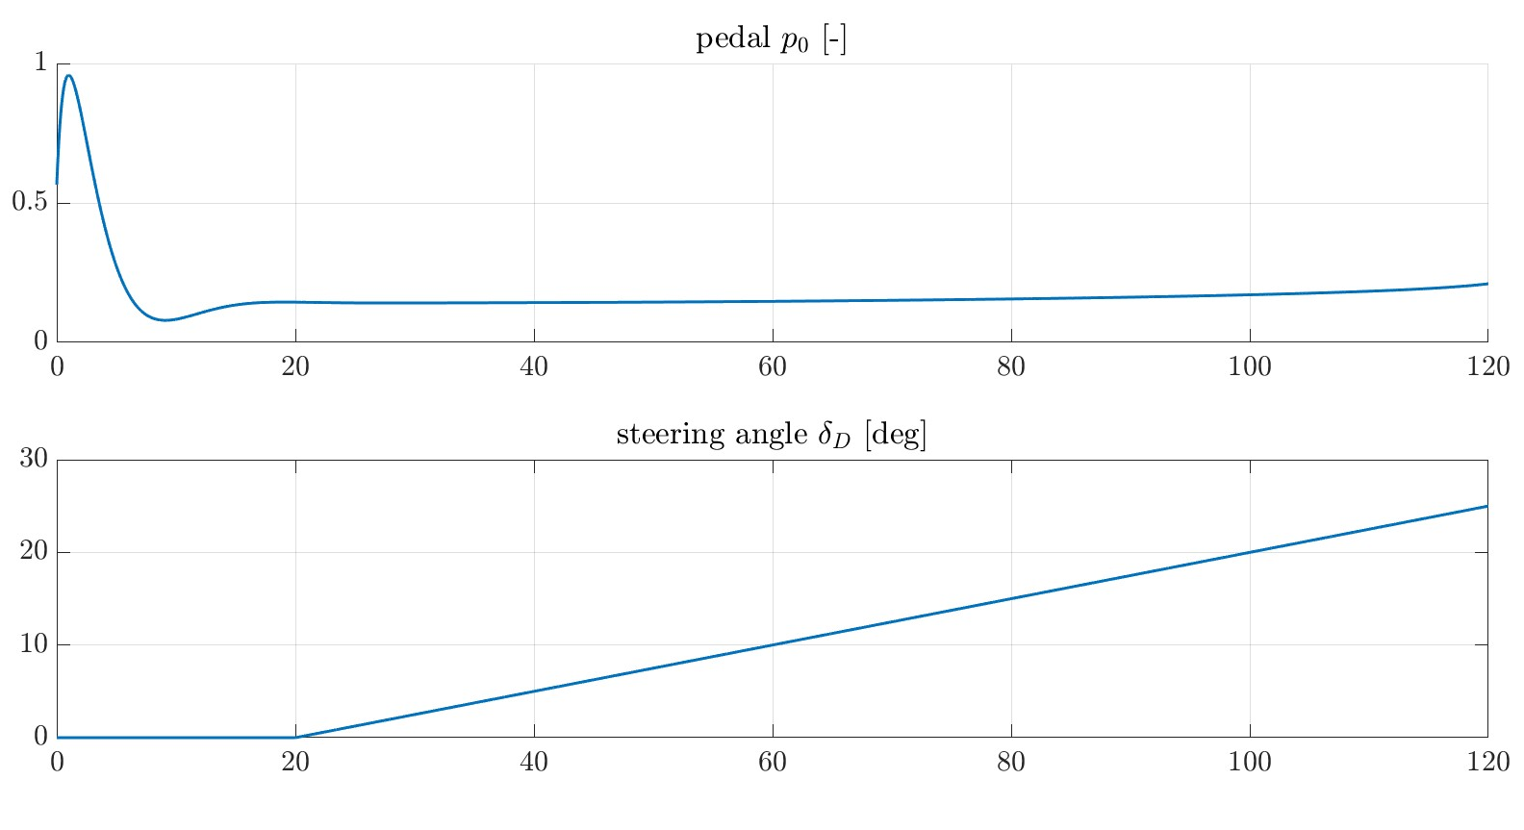
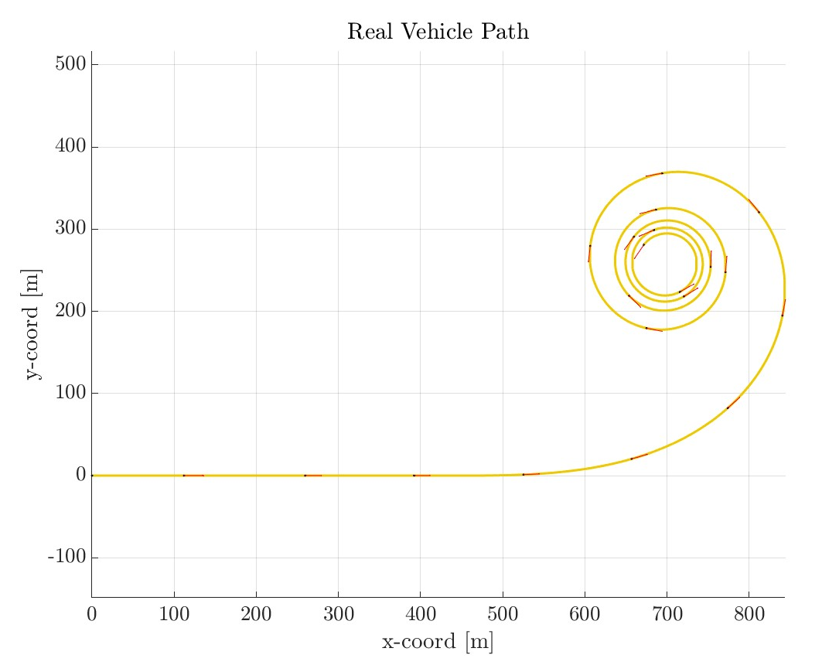
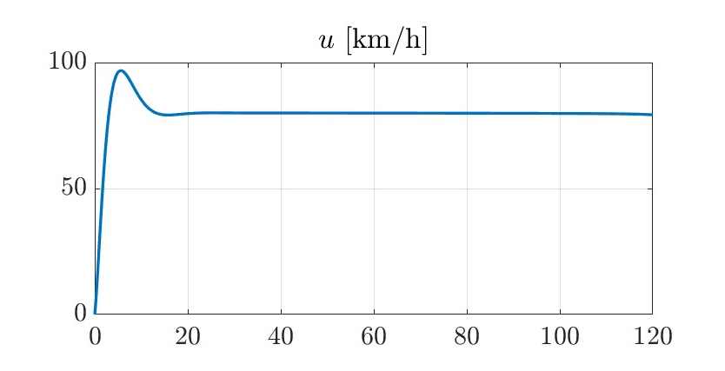
Steer ramp test
The steering angle increase linearly only from the moment that the steady state condition is achieved

Slide 4
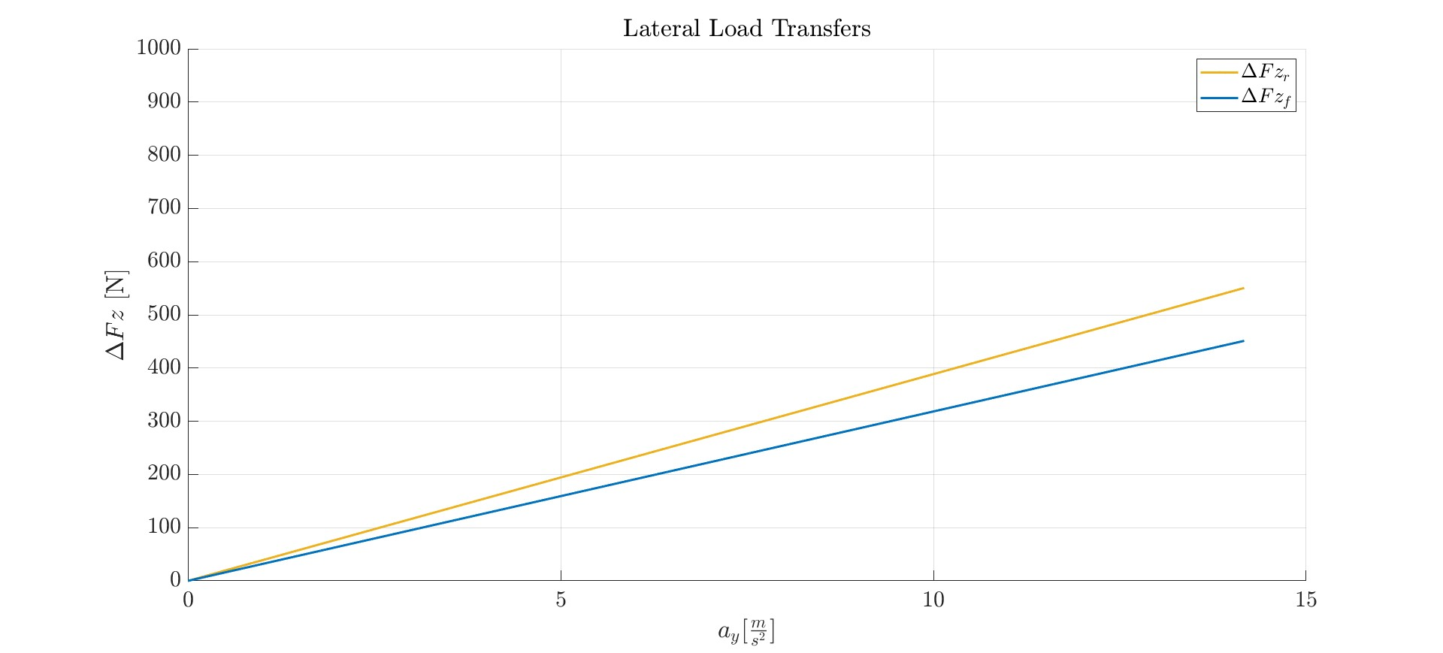
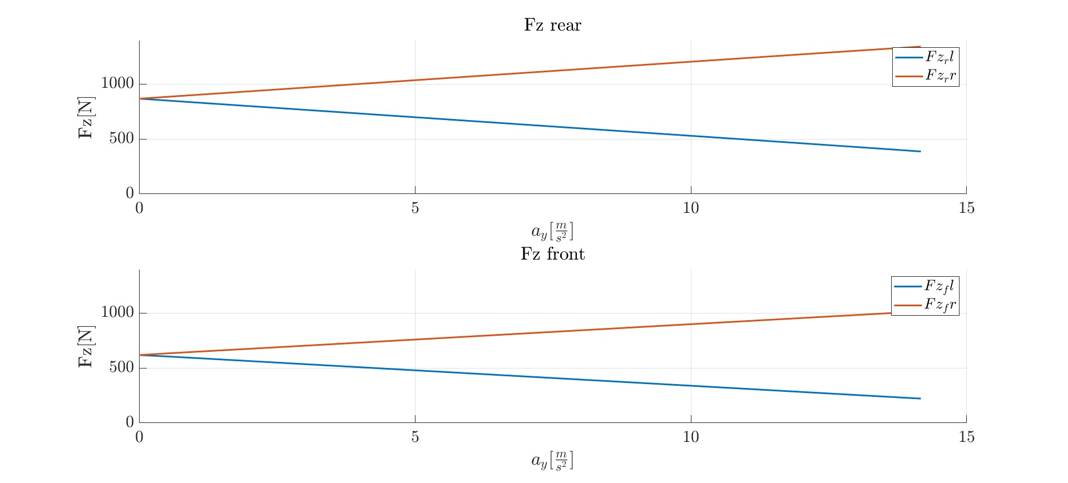
Lateral Load Transfer
The Lateral Load Transfer increase linearly with the lateral acceleration
From the plots on the right is easy to see that the outer wheels have to sunstain more load than the inner wheels

Slide 5
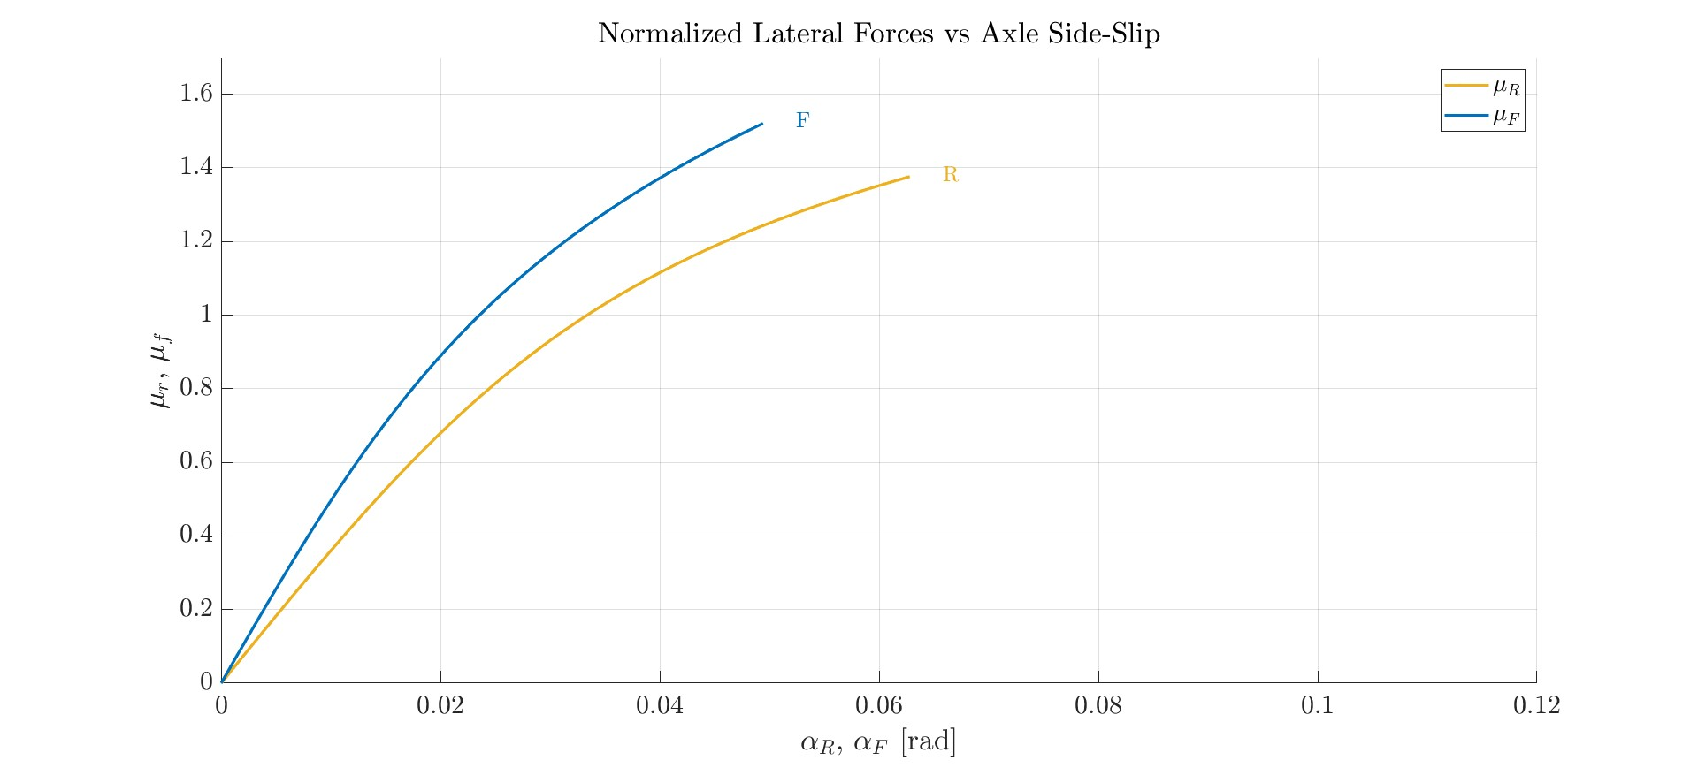
Axle Characteristics
The axle characteristics represent the total lateral force of an axle, as a function of the apparent side slip of the axle. In the figure the normalized axle characteristics are showed, which in steady state, at a given acceleration are equal for the two axle and equal to normalized acceleration.

Slide 6
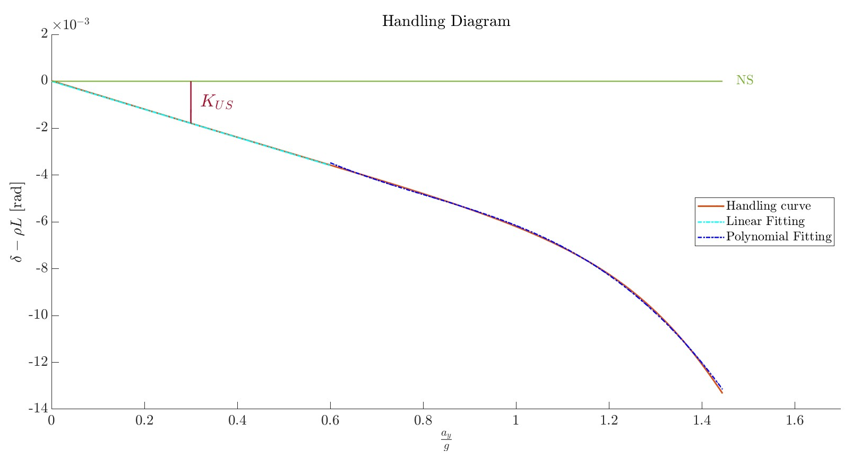

Handling Diagram
The handling diagram gives us the possibility to clearly recognize the oversteering behaviour of the vehicle we considered
Moreover, we computed the understeering gradient Kus:
fitting procedure of the linear part of the handling diagram → Kus = -5.99e-03
theoretically: $Kus=−\frac{1}{L∗g∗τ}(\frac{1}{Cyr}−\frac{1}{Cyf})$, with the cornering stiffness computed as the angular coefficient of the normalized lateral forces → Kus = -5.73e-03

Slide 7
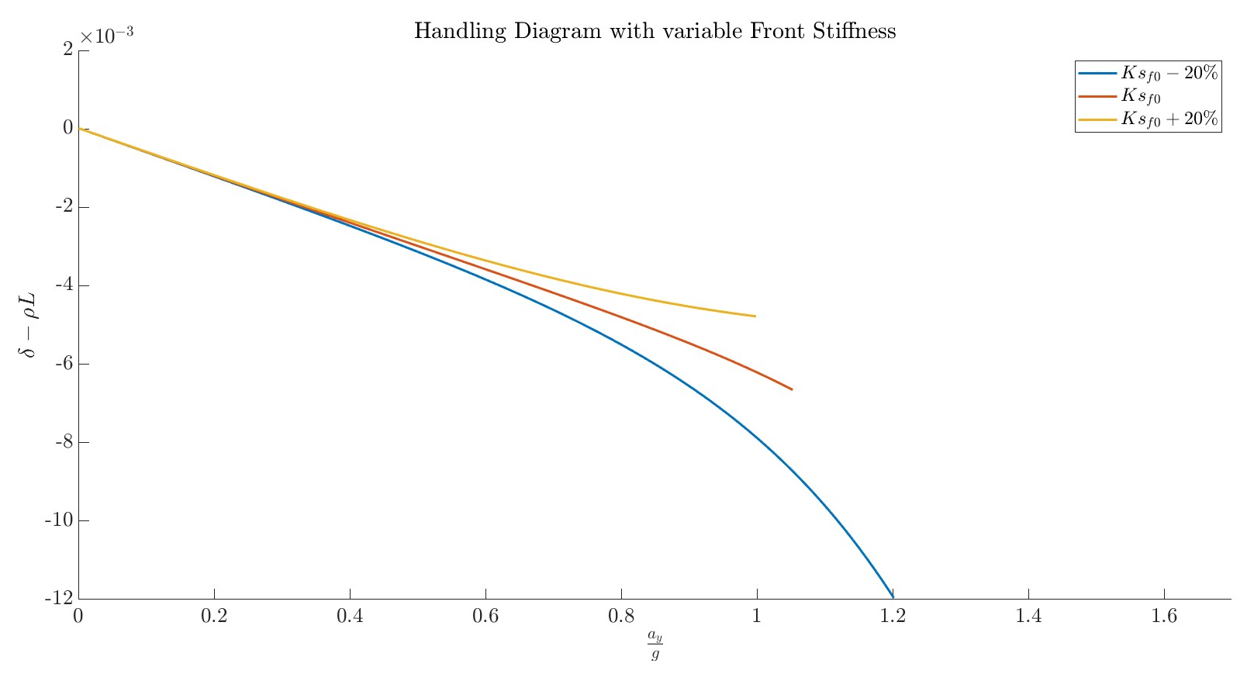
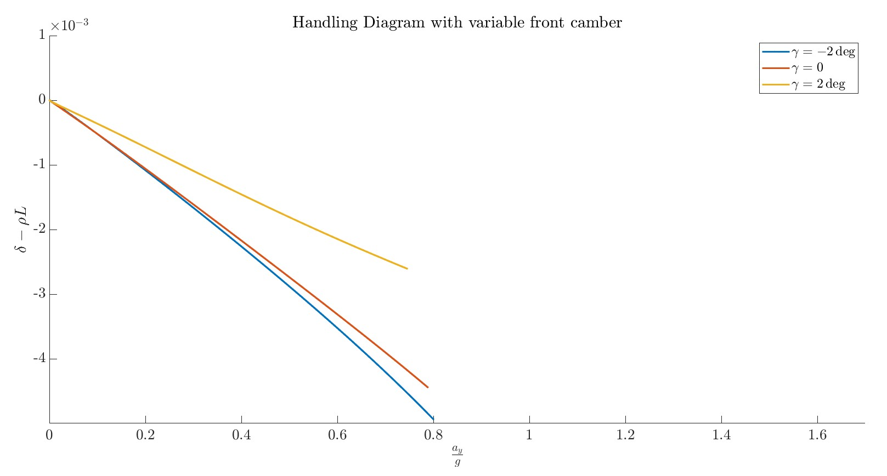
Effect of suspension stiffness and camber on handling
We carried on further analysis on the handling behaviour of the vehicle, changing the suspension stiffness at the front and also using different values of camber for the front wheels.
From the figures is possible to understand that this changes affects the behaviour of the vehicle.

Slide 8
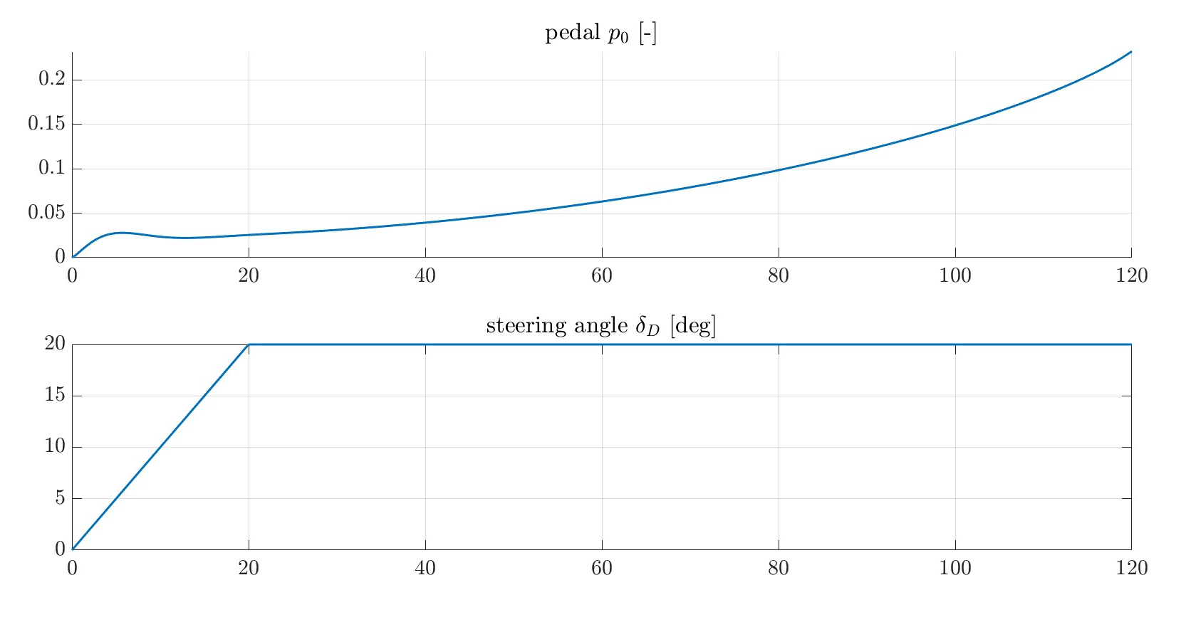
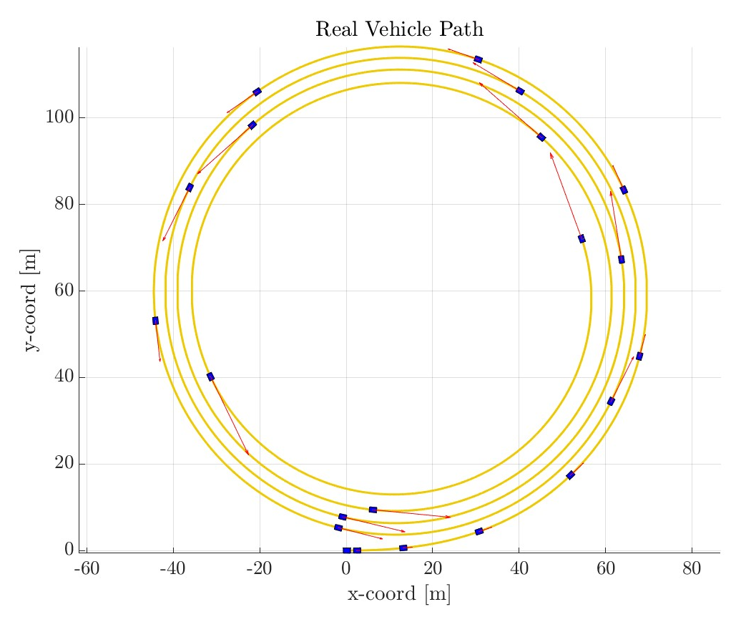
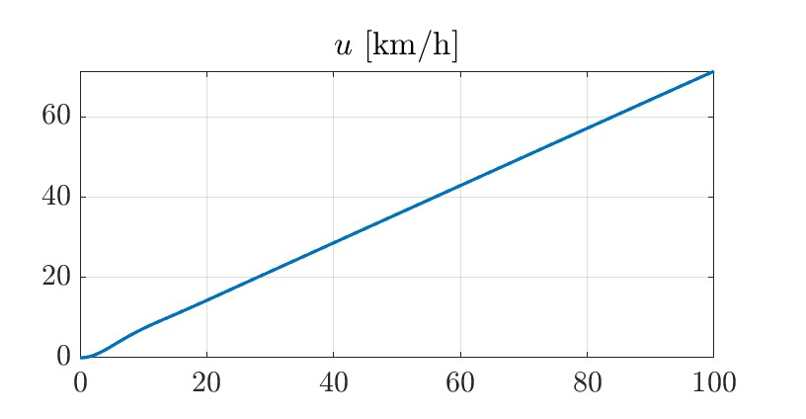
Speed ramp test
The velocity increase linearly controlled by a PID. Initially the steering angle increase slowly to reach constant value, in order to avoid sudden change

Slide 9
Results
The simulations carried on with this kind of test leads to equal results as the previous test, with similar plots of lateral load transfer and handling diagram. Also the value of Kus, that result very similar, confirms the validity of the test → Kus= -5.45e-03

Slide 10
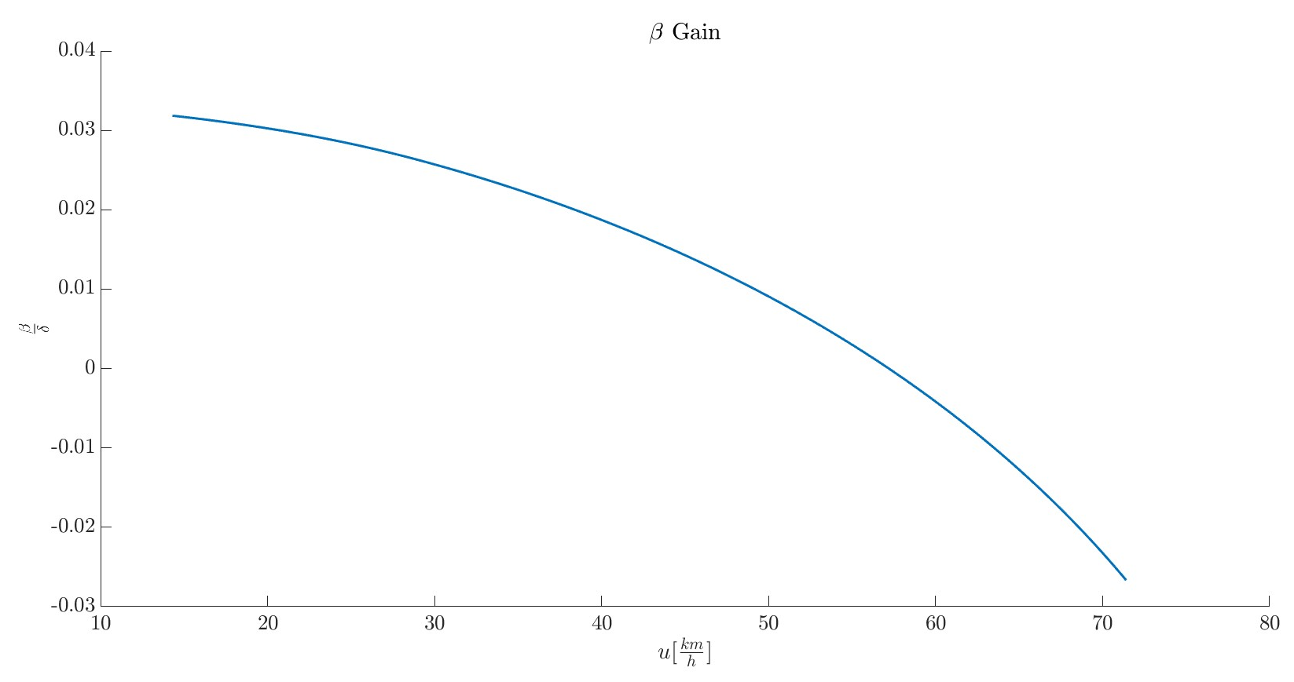
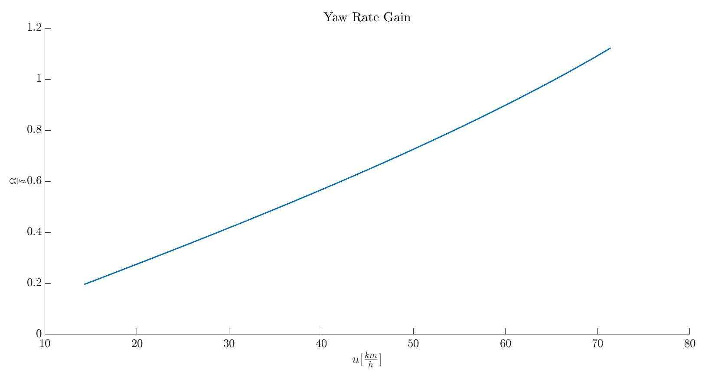
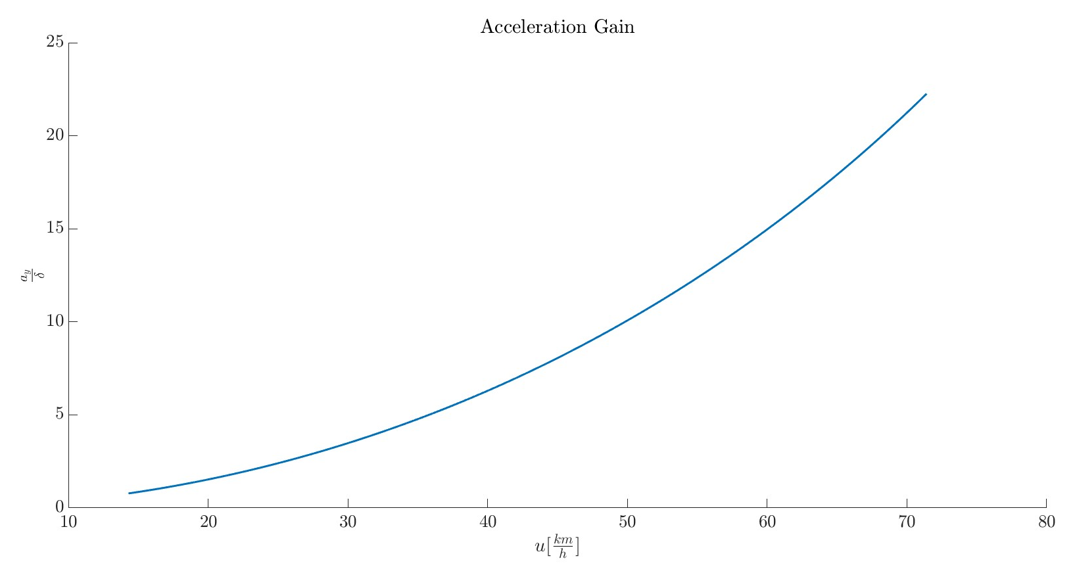
Steady-state Gains
Yaw Rate Gain
Side-Slip Gain
Acceleration Gain
Parameters that determine the response of the vehicle to steering inputs of the driver

